Slide 1
Notes:
AKA SELECT statement

Slide 2
Notes:
A copy of the data out of the database
Not changing or modifying; still stored on a database machine
Retrieving = select

Slide 5

Notes:
* Means everything (wildcard)

Slide 6

Notes:
Smaller table returned
Select these 3 columns from the invoices table and order them by invoice_total in descending format (3rd column)

Slide 7

Notes:
Instead of using column names, the invoice_id and invoice_total remains the same
The third is adding two columns together (credit_total and payment_total) then create a new column from those sums named total_credits
Now we’re only showing where invoice_id = 17
Create a new column, only showing a certain entry
Pay attention to the structure (commas) and always ends with a semicolon at the end
There’s not a total_credits column in the original “invoices” table
Whatever you retrieve from, it doesn’t go back to get updated
The copy data is the state what you’re manipulating

Slide 8

Notes:
Notice the invoice_date is proper
You can add extra parameters like DESC and ASC (default?)
37 rows = 37 entries
ORDER actually matters (how displayed matters to be retrieved)
This is like mot recent till least recent

Slide 9

Notes:
Relational operators work
Always SELECT something FROM somewhere WHERE conditions

Slide 10
Notes:
AS allows us to create a new column name (like AKA)

Slide 13
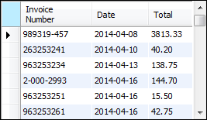
Notes:
Why do we have a quote @ the Invoice Number?
Because there’s a space in between, SQL is space sensitive
That’s why quotes are necessary
Will be useful since giving aliases, whatever code’s connected to that, it only knows the row by the new name
There’s no reference to the old name anymore
Want to hide some of the names of the column so it’s harder for attackers to attack the database

Slide 14
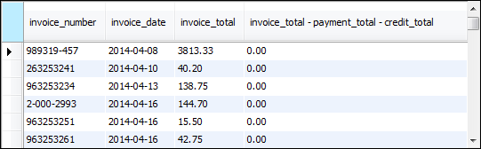
Notes:
The third column isn’t given a name
So the subtraction is just the name

Slide 16


Slide 17


Slide 18

Notes:
You can do different types of division

Slide 20

Notes:
Vendor_city and vendor_state are 2 separate columns in the original table
When CONCAT, you’re joining them into one (to get 3 column)
Useful for joining first name and last name
Or do it with addresses
Even if they’re stored separately

Slide 21

Notes:
Notice it’s also concatenating the comma and white spaces (i.e. ‘, ‘) → a string

Slide 22

Notes:
You can use as many CONCATs as you want
Make sure to put the things you’re concatenating in parentheses
The ‘s Address is what is being added
Why do we have an extra single quote in the beginning?
It’s an escape character for the next one, “please treat it as is”
The quote can also be used for slash and parens

Slide 24

Notes:
See the concat w/ left?
- Notice how LEFT takes the 1st leftmost character to CONCAT and make initials

Slide 25

Notes:
Manipulates formats

Slide 26


Slide 27


Slide 28


Slide 29


Slide 30


Slide 31
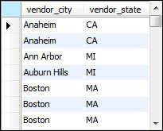

Slide 32
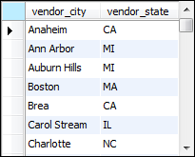

Slide 37


Slide 38

Notes:
Parens matter
Without the parens, it’ll run the first whole thing and then AND it with the next one

Slide 47
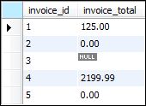

Slide 48



Slide 49

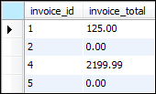

Slide 50
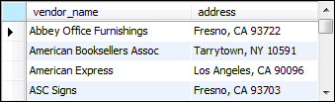

Slide 52
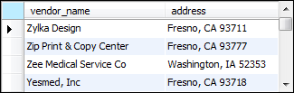

Slide 53
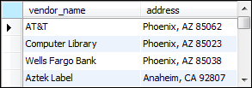

Slide 54
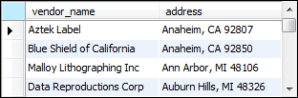

Slide 55
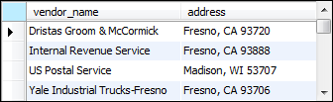

Slide 56

Notes:
Column 1 = vendor_name
Column 2 = address
ORDER BY = SORT BY
Notice the same city names are grouped together, and then those are put in order
Sort by column 2 first and then column 1

Slide 57
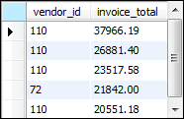
Notes:
LIMIT means we just wanna see the first 5 rows

Slide 58

Notes:
Start at 3rd row because row 1 = 0, row 2 = 1, row 3 = 2
Then three rows next to it??

Slide 59
